Slide 1
Visualization of Internal Blockchain Processes
Shao-Chun Ma
July 23, 2018

Slide 2
Agenda
Introduction
Related Works
Methodology
Application
Scenarios
Summary
References

Slide 3
Motivation
In a proof-of-work blockchain network, miners compete with each other by adding blocks on the top of the longest blockchain
Network latency between nodes
Miners have different mining strategies
e.g., the minimum value of the mined transactions
Visualize the mining processes

Slide 4
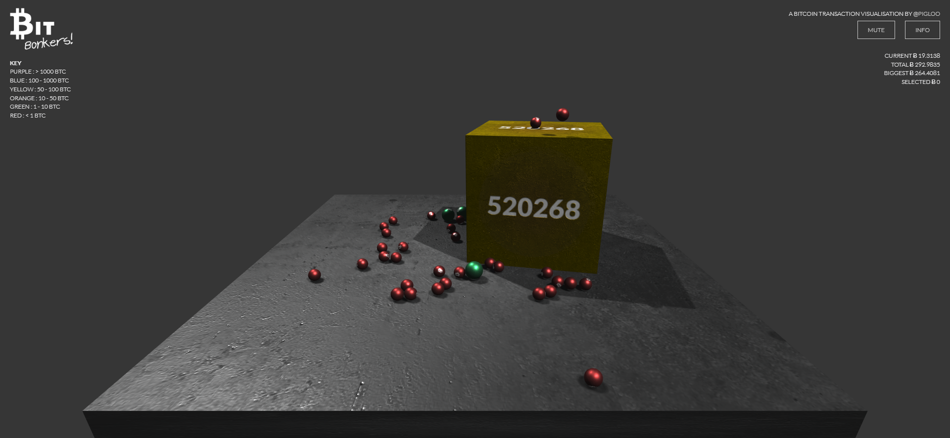
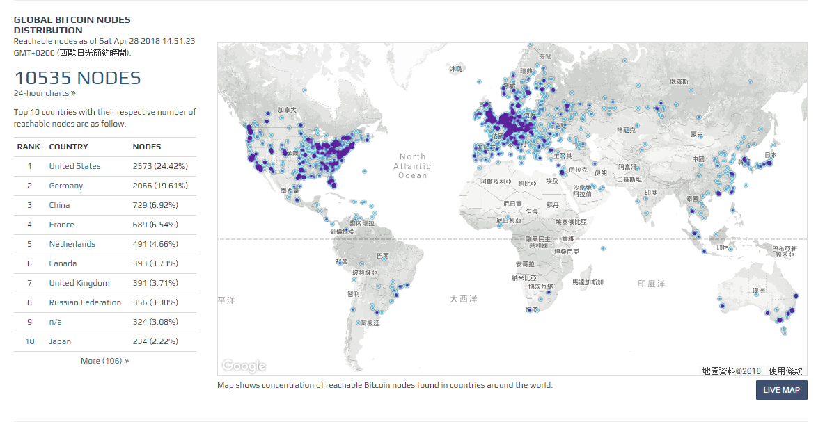
Bitcoin Visualization
Cube: block
Balls: transactions
Blue dots: nodes
https://bitbonkers.com/
https://bitnodes.earn.com/

Slide 5
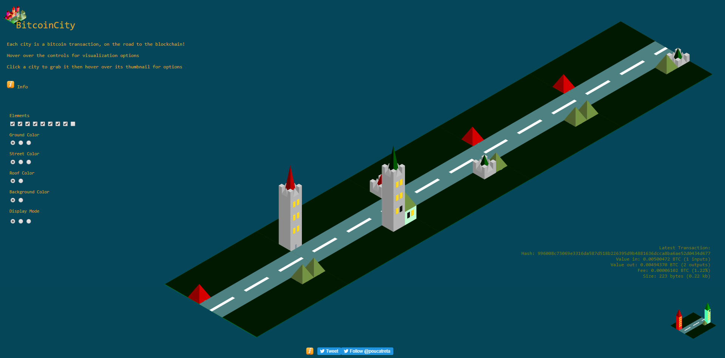
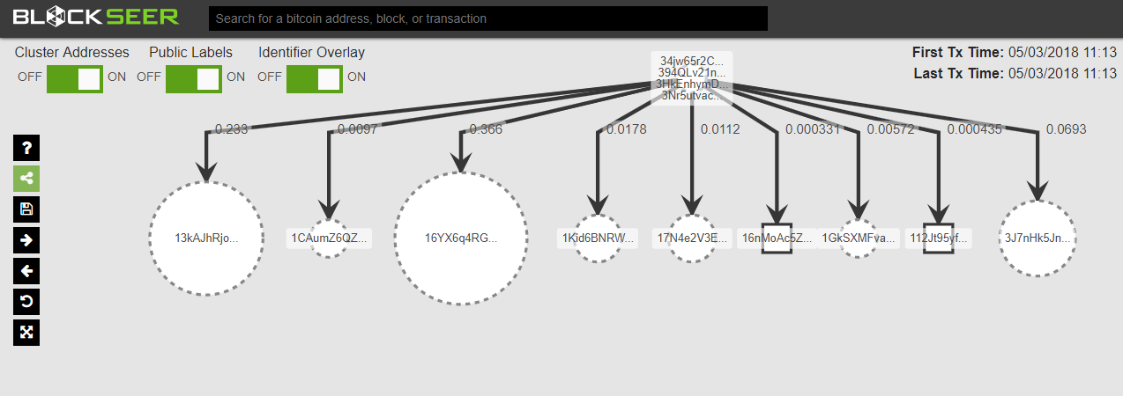
Bitcoin Visualization
Buildings: blocks
Road: chain
Root: transaction
Leaves: outputs of transaction
http://bitcoincity.info/
https://www.blockseer.com/

Slide 6
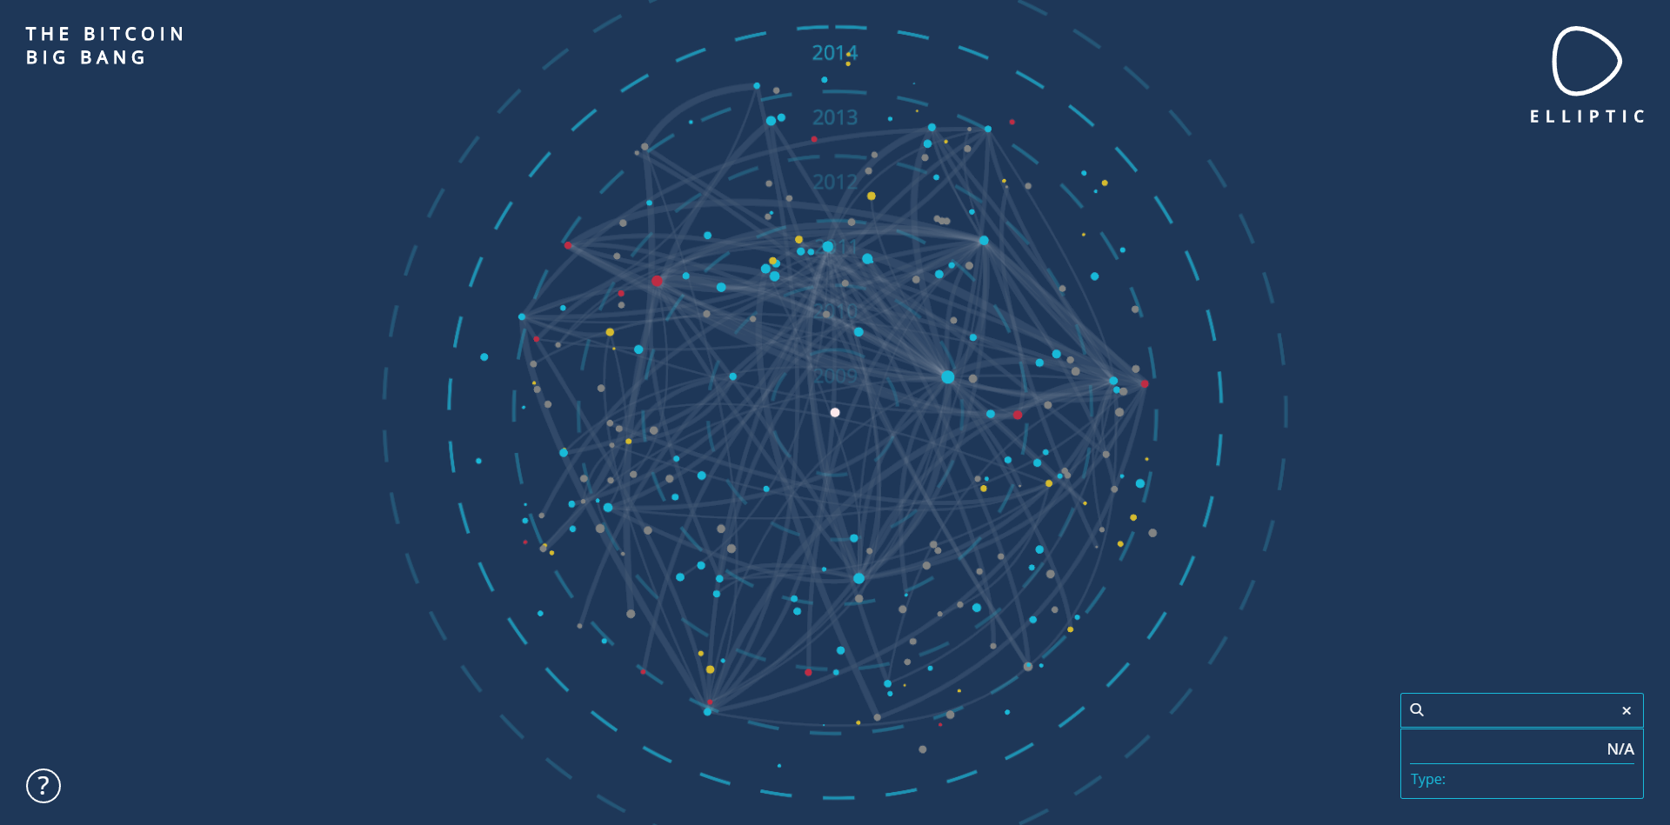
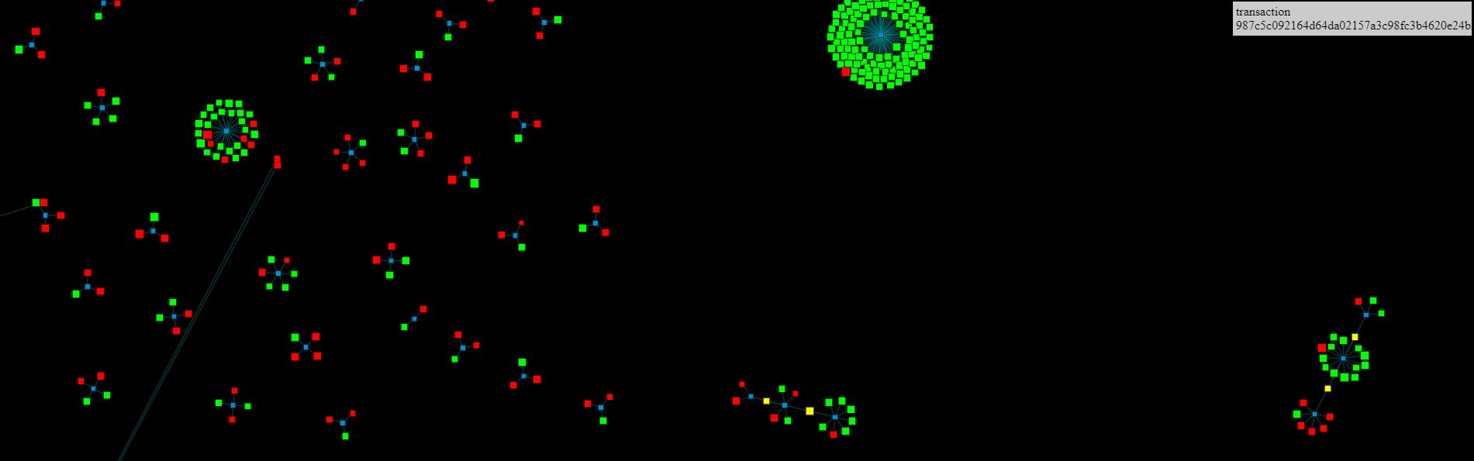
Bitcoin Visualization
Cells: transactions
Green dots: outputs of transaction
Big Bang
Dots: blocks
https://dailyblockchain.github.io/
https://info.elliptic.co/hubfs/big-bang/bigbang-v1.html

Slide 7
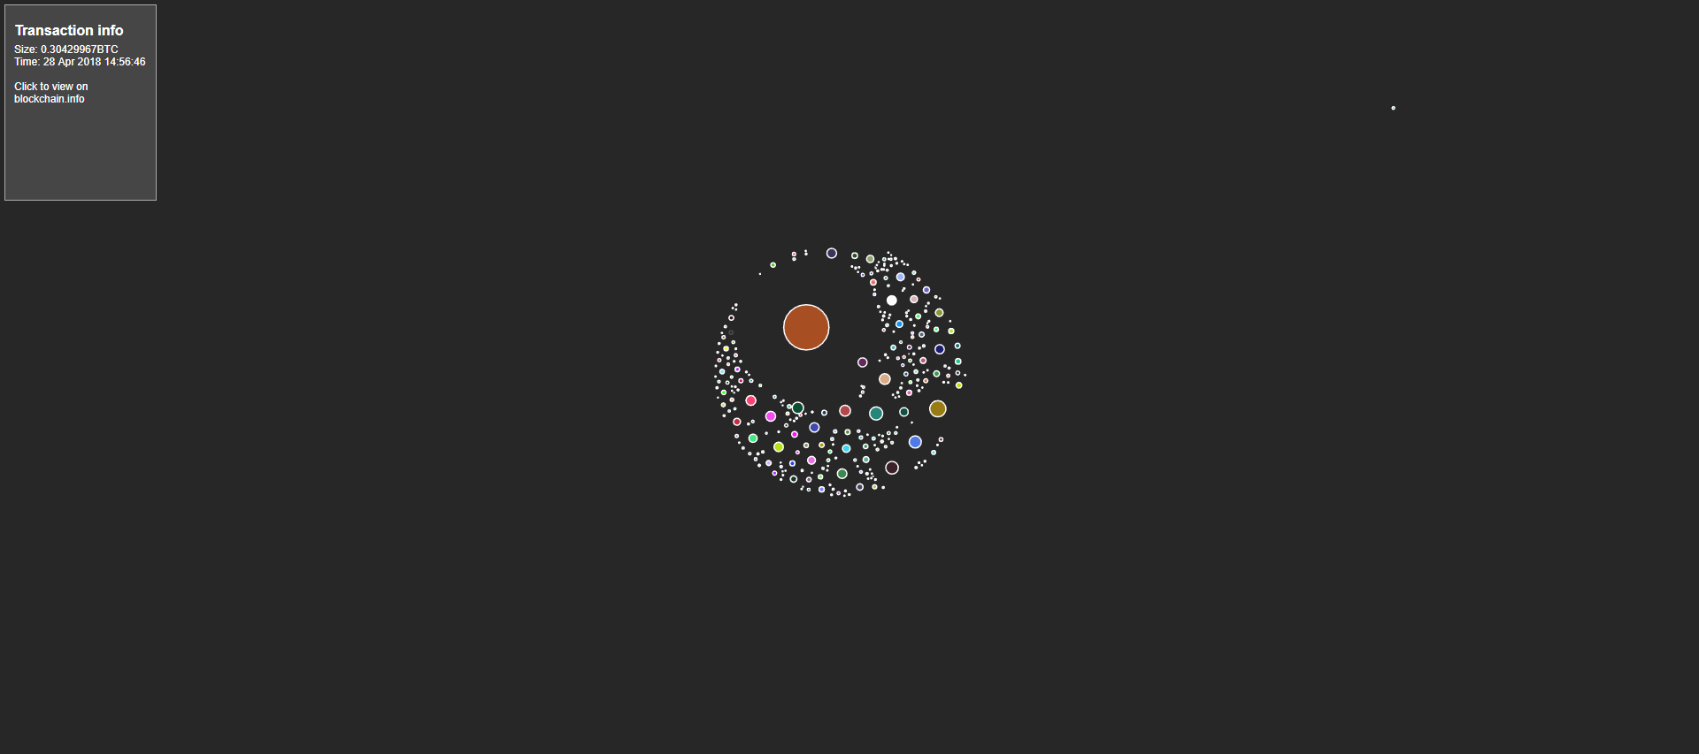
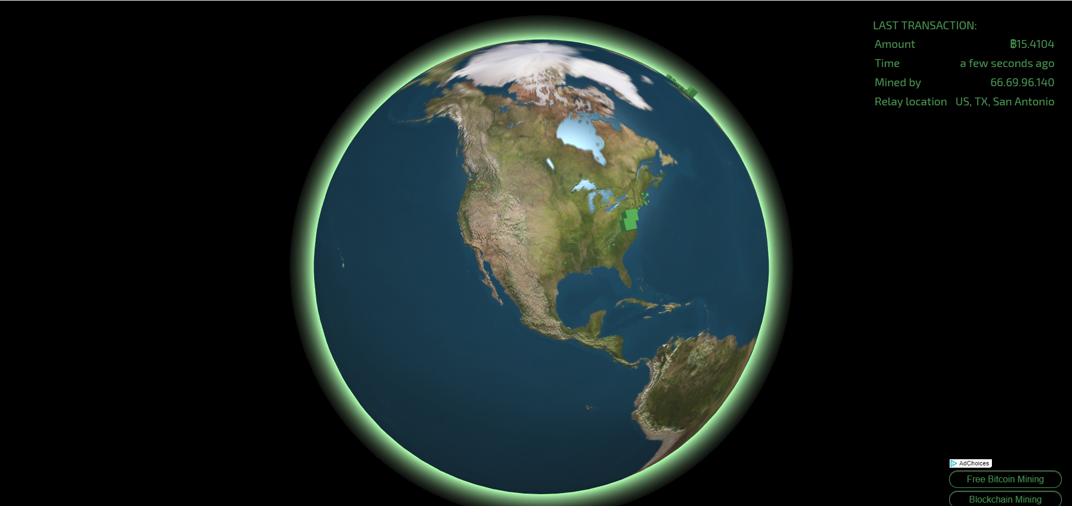
Bitcoin Visualization
Circles: transactions
Green cubes: blocks
http://bitcoin.interaqt.nl/
https://blocks.wizb.it/

Slide 8
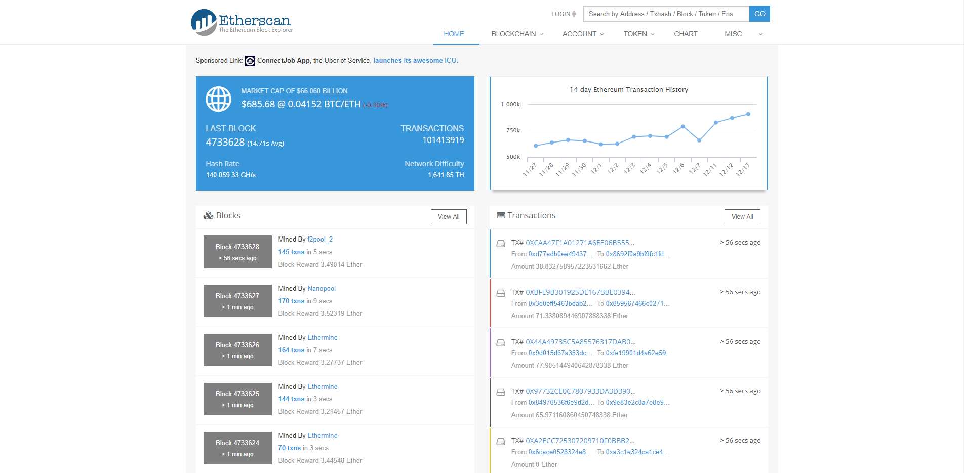
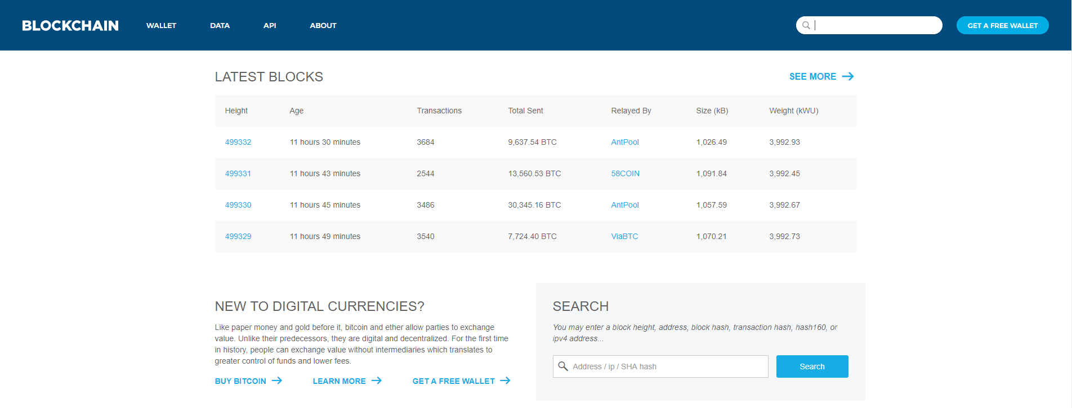
Tableau Visualization
Rows: blocks
Rows (left): blocks
Rows(right): transactions
https://blockchain.info/
https://etherscan.io/

Slide 9
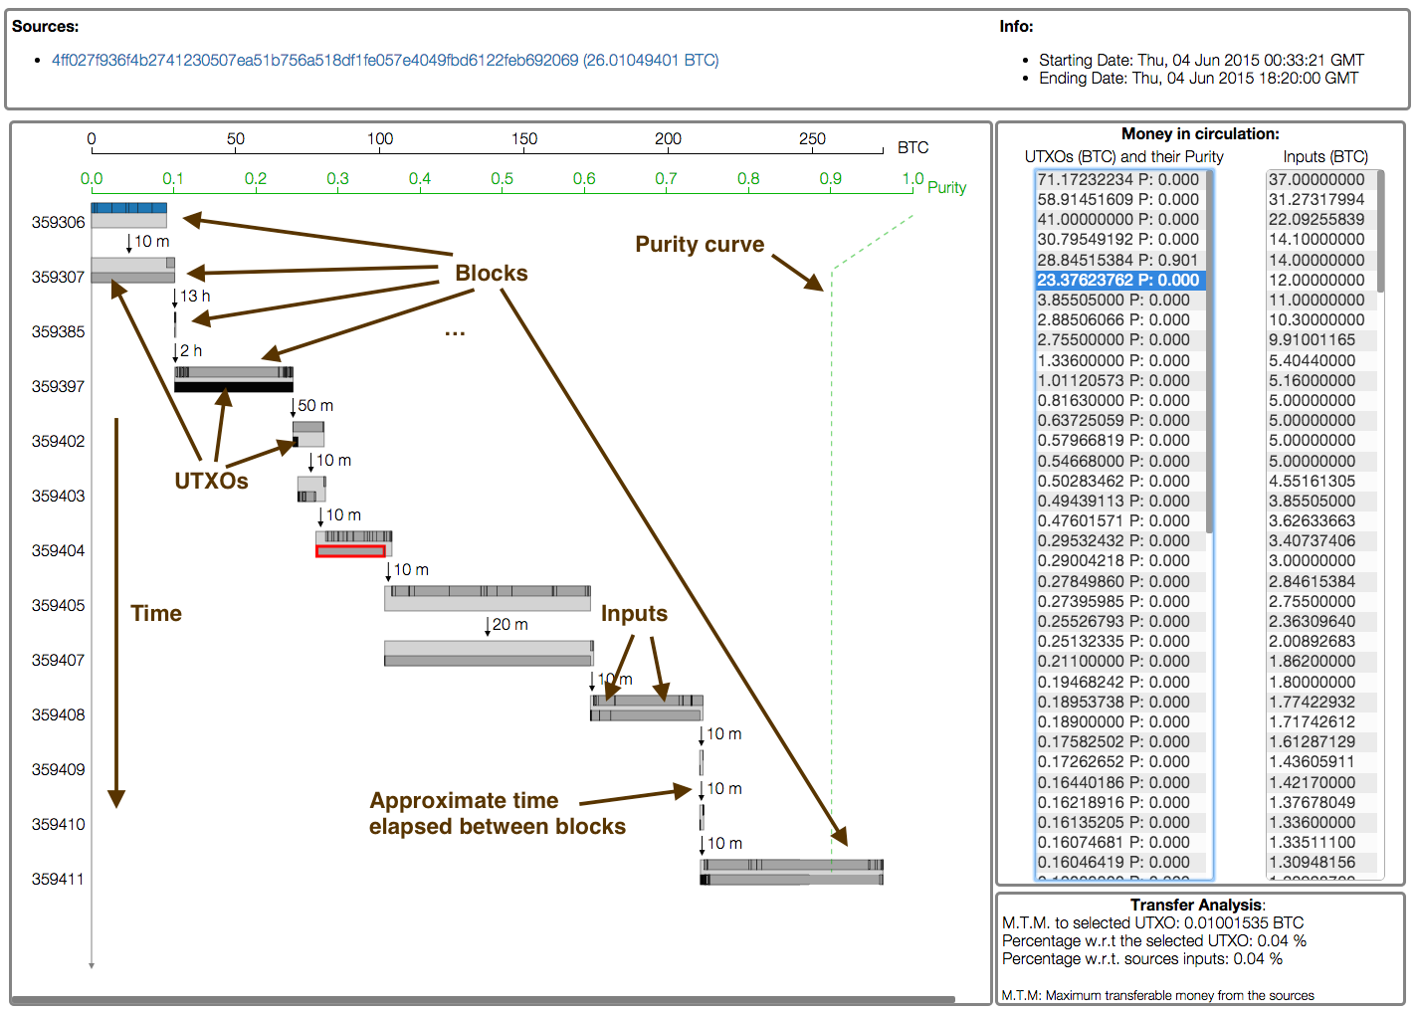
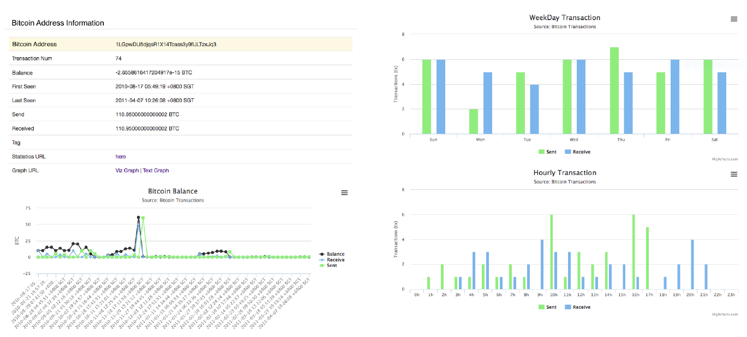
Analysis Visualization
Bars: transactions
Frequency of transactions
Battista 2015
Kuzuno 2017

Slide 10
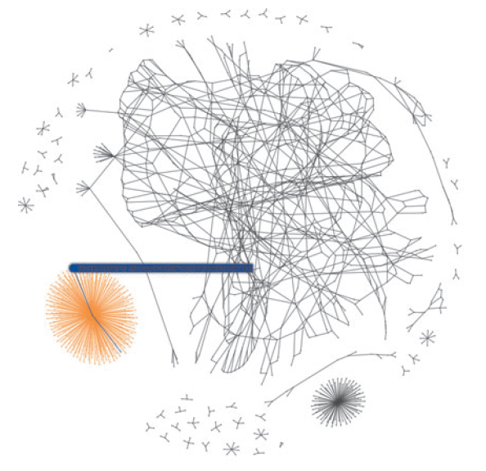
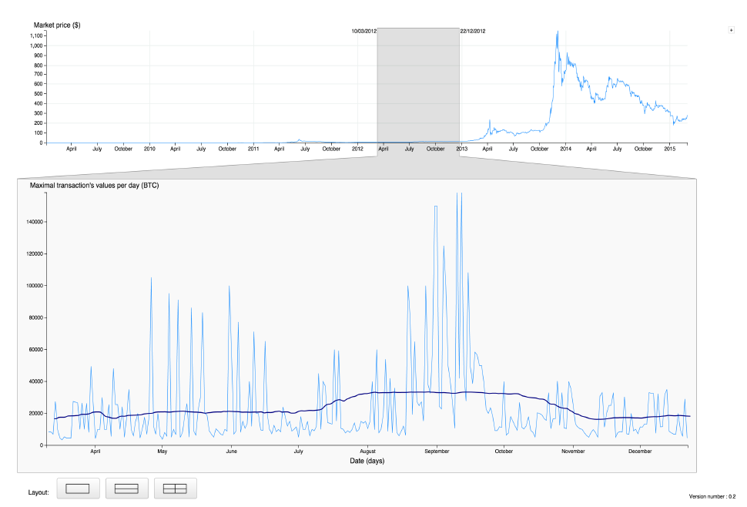
Analysis Visualization
Big data
Connections of transactions
Marketing value of Bitcoin
McGinn 2016
Saublet 2015

Slide 11
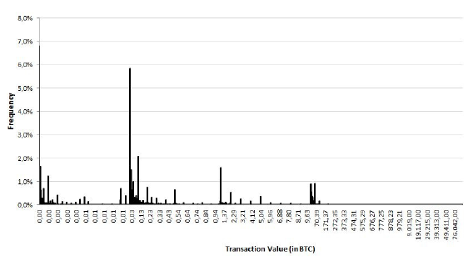
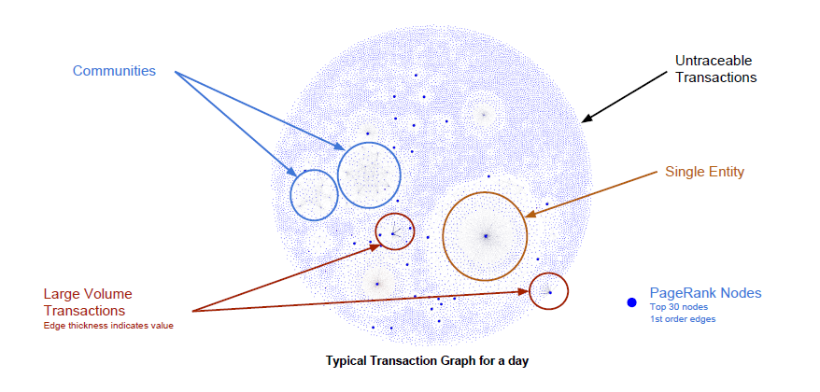
Analysis Visualization
Patterns of transactions
Marketing value of Bitcoin
Fleder 2015
Baumann 2014

Slide 12
Problems
Tableau visualization and analysis visualization only display static information
Although the Bitcoin visualization is dynamic animation, the forks, i.e., the competition of miners, are not displayed
Cannot identify the influence of different mining strategies and network latency

Slide 13
Overview
Nodes: a transaction generator, miners, nonminers
Network latency
Miners have different mining strategies
An application which can display the mining activities step by step
Upload a predefined file to replay the same mining processes

Slide 14
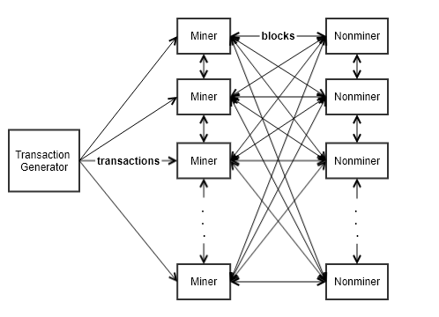
Factors
Network Latency
Mining Strategy
Transaction generator ⇒ Miners
Miners ⇔ Nonminers
Mining time (computing power)
Minimum value of transactions
Number of mined transactions in a block
Maximum number of pending transactions in the transaction pool

Slide 15
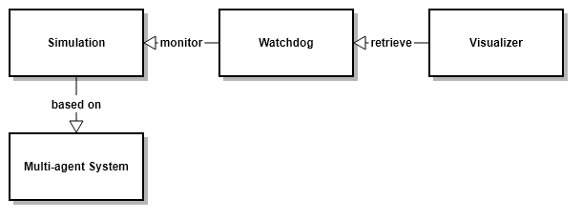
Application Architecture
Blockchain simulation: based on the multi-agent system
Watchdog: monitoring the blockchain system
Visualizer: visualizing the mining processes

Slide 16
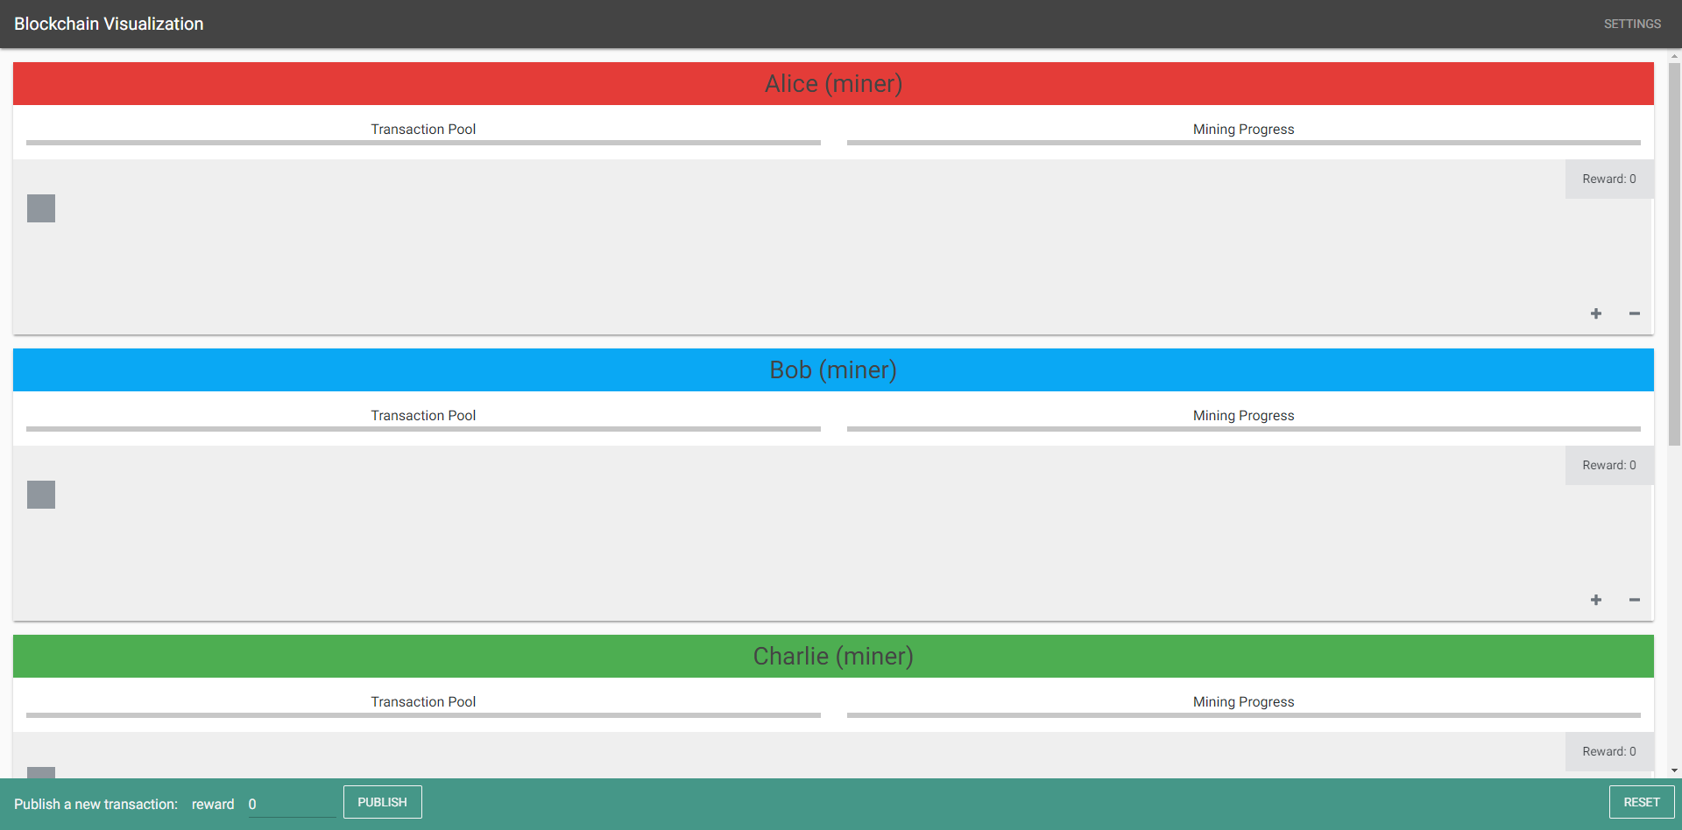
Visualization
Beginning
Rows: miners
Gray blocks: genesis blocks

Slide 17
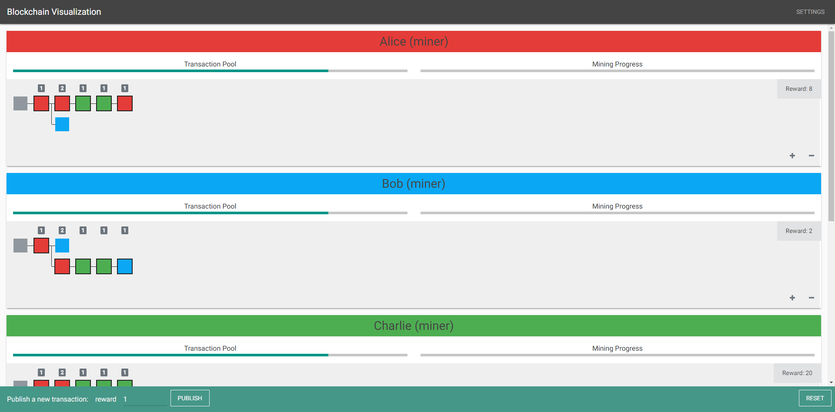
Visualization
After mining
Squares: blocks
Colors: sources

Slide 18
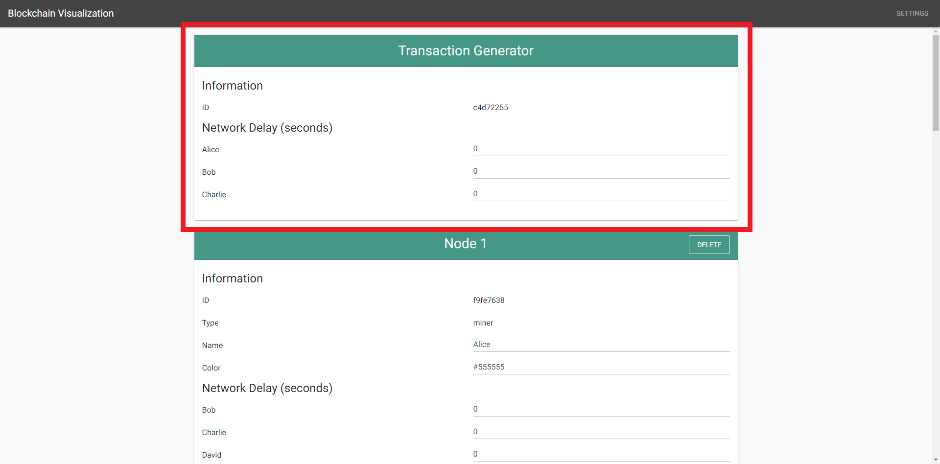
Settings (Transaction Generator)
ID
Network Delay

Slide 19
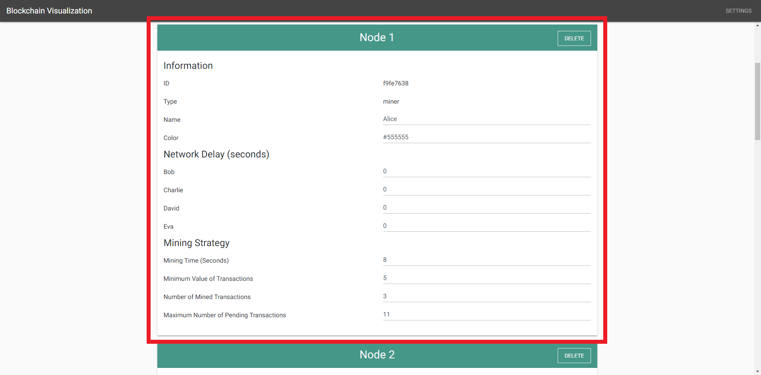
Settings (Miner)
ID
Name
Color
Network Delay
Mining Strategy

Slide 20
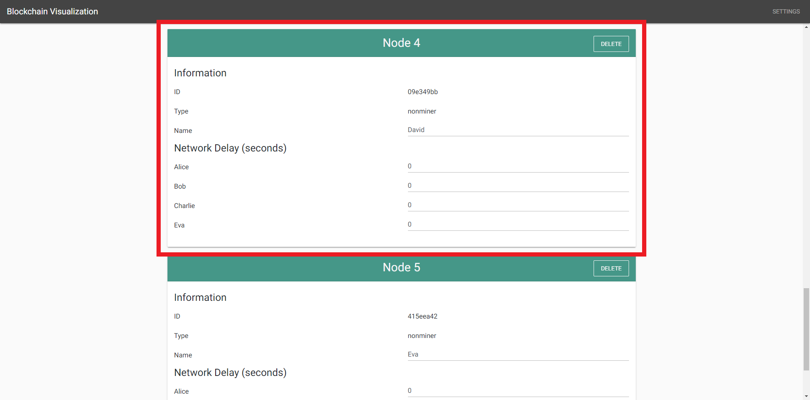
Settings (Nonminer)
ID
Name
Network Delay

Slide 21
Influence of Mining Strategy
Three miners: Alice, Bob, Charlie
Alice has the most chance to mine
because Alice’s minimum value of transactions and number of mined transactions are the lowest comparing to Bob’s and Charlie’s
The network latency is low, so the publish of blocks is fast

Slide 22

Influence of Mining Strategy

Slide 23
Influence of Network Latency
Four miners: Alice, Bob, Charlie, David
The four miners are partitioned into two groups
The network latency is high between different groups
The network latency is low between different groups
The mining time is shorter than the high network latency

Slide 24
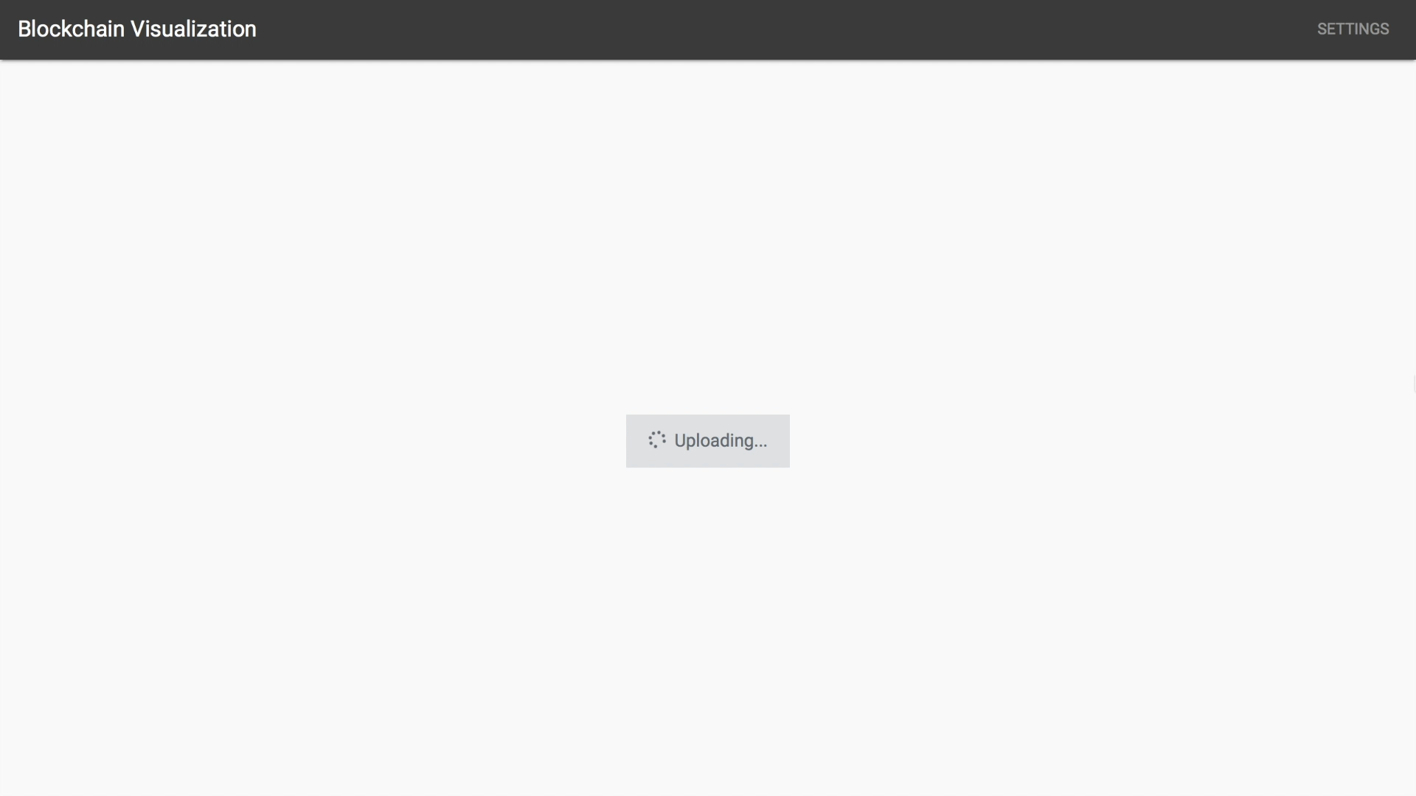
Influence of Network Latency

Slide 25
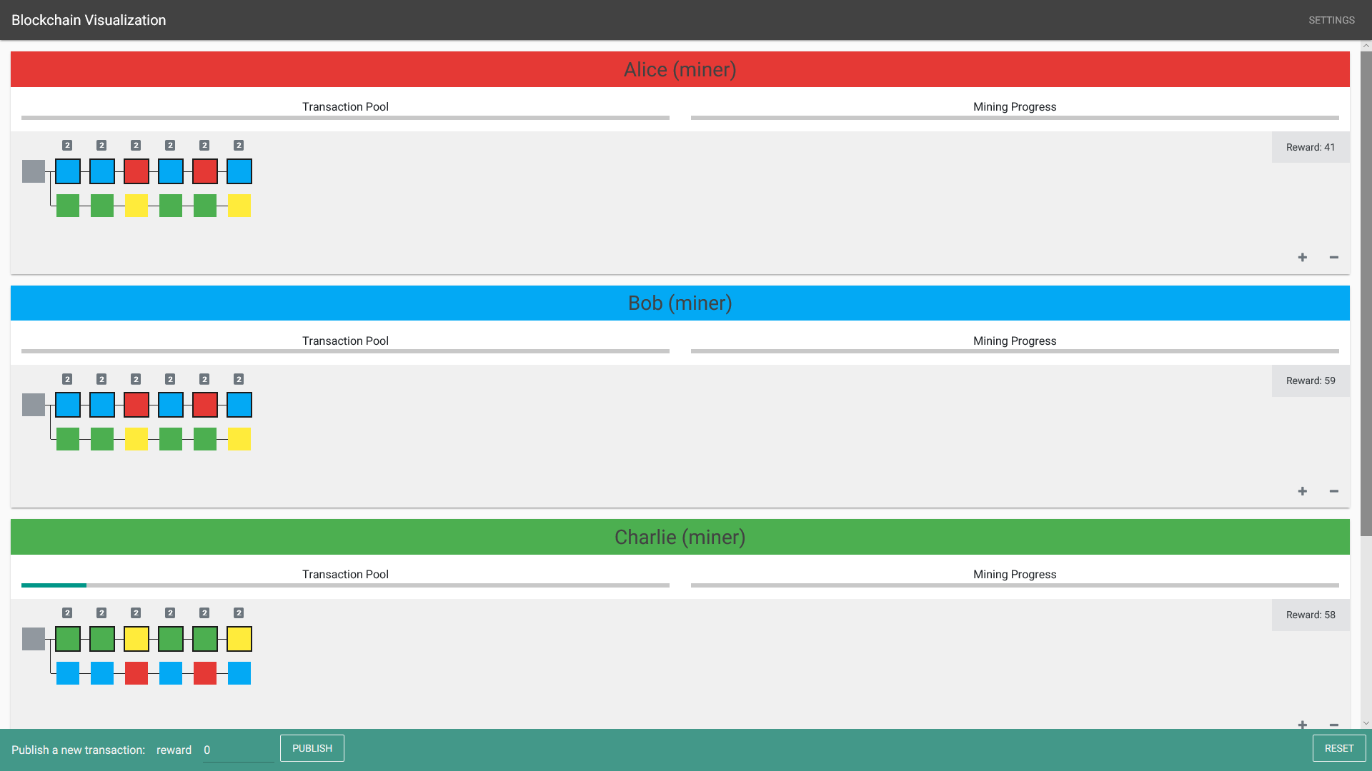
Influence of Network Latency
Problem: The forks cannot be merged afterward
Reason: The parameters are fixed during the process

Slide 26
Thesis Process
Initial Idea
Providing the visualization which displays the mining activities of all nodes step by step with network latency
Preparation
Studying related works about blockchain visualization
Design the visualization
2D visualization is enough for simplicity
Using different colors to distinguish sources
Not considering different sizes of blocks to distinguish values

Slide 27
Thesis Process
Preparation
Exploring blockchain platforms such as Ethereum and Hyperledger
Considering mining strategies
Blockchain platforms do not provide different mining strategies
We need a simple blockchain simulation
Considering multi-agent systems as the solution (agents = nodes)
Decide the architecture
Simulation, Watchdog, Visualizer

Slide 28
Thesis Process
Implementation
Choosing a JavaScript multi-agent system
Simulation, Watchdog, and Visualizer are implemented in JavaScript
JavaScript does not support multithreading
The schedule of network latency is not perfect
Result
The mining processes are influenced by mining strategies and network latency
The visualization is easy to understand and adjusted
Replaying the same mining processes

Slide 29
References
T. A. Sundara, I. Gaputra, and S. Aulia, “Study on blockchain visualization,” Sept 2017.
H. Kuzuno and C. Karam, “Blockchain explorer: An analytical process and in- vestigation environment for bitcoin,” in 2017 APWG Symposium on Electronic Crime Research (eCrime), April 2017, pp. 9–16.
L. Saublet, “Bitcoin visualization,” Master’s thesis, Université Paris-Sud, Au- gust 2015.
M. Fleder, M. S. Kester, and S. Pillai, “Bitcoin transaction graph analysis,” Feb 2015.
A. Baumann, B. Fabian, and M. Lischke, “Exploring the bitcoin network,” in WEBIST 2014 - Proceedings of the 10th International Conference on Web Information Systems and Technologies, vol. 1, 04 2014.
D. McGinn, D. Birch, D. Akroyd, M. Molina-Solana, Y. Guo, and W. J. Knot- tenbelt, “Visualizing dynamic bitcoin transaction patterns,” vol. 4, no. 2, 2016.
G. D. Battista, V. D. Donato, M. Patrignani, M. Pizzonia, V. Roselli, and R. Tamassia, “Bitconeview: visualization of flows in the bitcoin transaction graph,” in 2015 IEEE Symposium on Visualization for Cyber Security (VizSec), Oct 2015, pp. 1–8.

